Slide 1
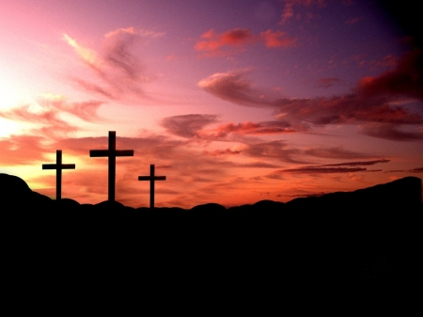
Holy Week
By Theo Wiseman

Slide 2
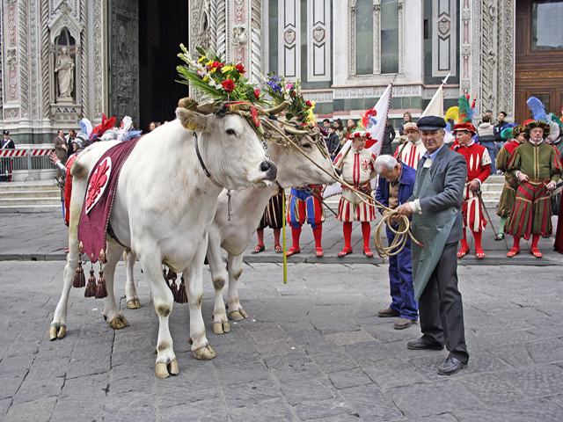
Holy Week in Italy
They hand out olive branches to the people in church.
They perform a ritual called Lunissanti which has the members of the brotherhood of the Holy Cross wearing white hooded tunics.
They would eat grilled lamb, sweets and cakes in the shape of doves.

Slide 3
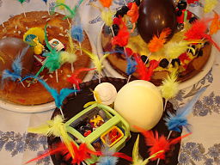
Holy Week in Spain
Large floats with Jesus on the crucifix goes through the towns.
Godparents make a cake called Monas which have colourful decorations.
Rag Dolls called Judas dolls are torn apart or thrown into the air.

