Slide 1

Holy Week
The Adventures Of
By Theo Wiseman

Slide 2

Palm Sunday
. Jesus rode through the streets of Jerusalem
People placed palm leaves on the floor for Jesus to ride on.

Slide 3
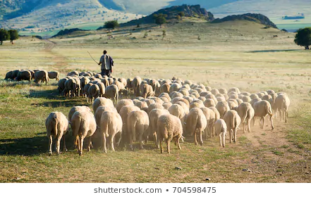
HOLY MONDAY AND TUESDAY.
Jesus freed the animals from being killed.
Pharisees made a plan to kill Jesus.

Slide 4

ASH WEDNESDAY
Judas made plans with pharisees to kill Jesus.
In church we have crosses on our heads.

Slide 5
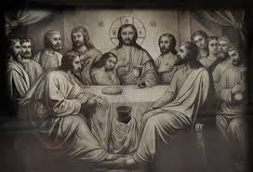
THE LAST SUPPER.
Jesus said This is my body take and eat.
Jesus said This is my blood take and drink.
Jesus washed the feet of the Discples.

Slide 6
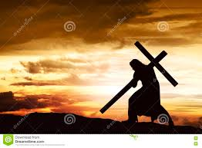
GOOD FRIDAY
Jesus made a cross and dragged it up a hill.
Jesus wore a crown of thorns.

Slide 7
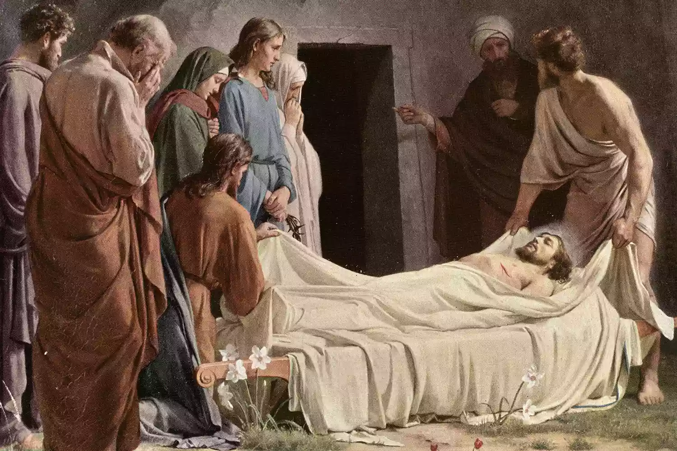
SABBATH SATURDAY
Jesus lay in the tomb after his crusifixition.

Slide 8
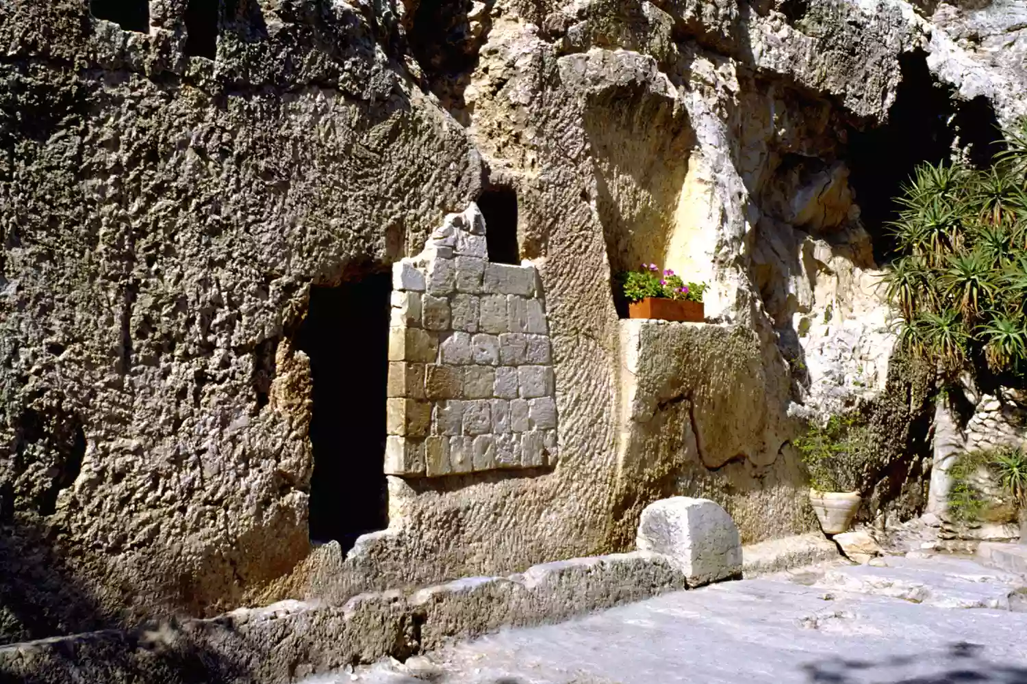
RESURRECTION SUNDAY
An angel came to say that Jesus had rose from the dead

