Slide 1

The story of the Presentation.
R.E. Nursery class 2021

Slide 2
Nursery Prayer
From my head to my heart, to my shoulder to my shoulder. I belong to Jesus.
Dear god you know me and you love me.
I want to know you and love you too.
Amen
From my head to my heart, from my shoulder to my shoulder. I belong to Jesus.

Slide 3
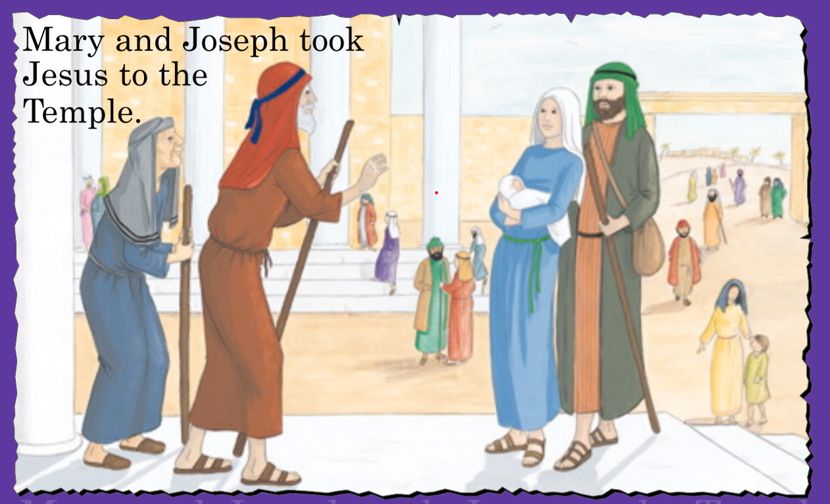

Slide 4
Question time.
What do you see in the picture?
Why did Mary and Joseph take Jesus to the Temple?
Who were the people that they met?
Why did Simeon and Anna go to the Temple?

Slide 5

How important is light ?
How do we feel in the dark?
What does the light mean? And how does it help us?

Slide 6
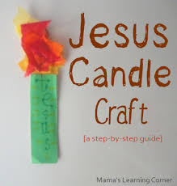
Activity time.
Use figures or puppets to re-enact the story of Mary and Joseph taking Jesus to the Temple.
Make a candle tell your grown up what the light means to you.

Slide 7
Nursery Prayer
From my head to my heart, to my shoulder to my shoulder. I belong to Jesus.
Dear god you know me and you love me.
I want to know you and love you too.
Amen
From my head to my heart, from my shoulder to my shoulder. I belong to Jesus.

