Slide 1
Play Dough Syllables

Slide 2
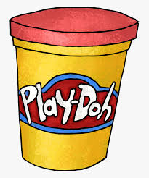
You will Need.
Play -dough

Slide 3
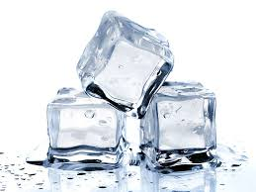
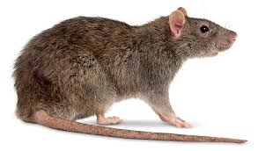
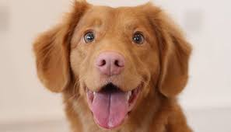
Find the syllables
Ice
Ice
1 syllable
Dog
Dog
1 Syllable
RAT
Rat
1 Syllable

Slide 4
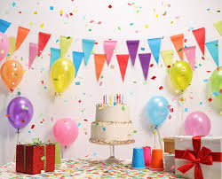
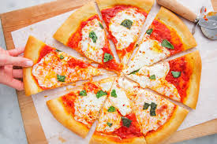
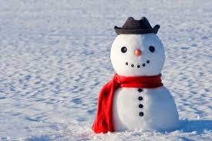
Try and find the syllables
Snowman
Snow-man
2 Syllables
Party
Par-ty
2 Syllables
Pizza
Piz-za
2 syllables

Slide 5
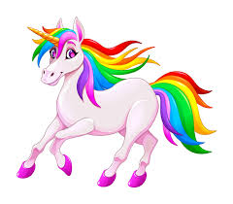

Try and find the beats in these words…
Banana
Ba-na-na
3 Syllables
Unicorn
U-ni-corn
3 Syllables
Flamingo
Fla-Min-go
3 Syllables

