Slide 1
Celebrations

Slide 2
Nursery Prayer
From my head to my heart, to my shoulder to my shoulder. I belong to Jesus.
Dear god you know me and you love me.
I want to know you and love you too.
Amen
From my head to my heart, from my shoulder to my shoulder. I belong to Jesus.

Slide 3
What is a celebration ?
A celebration is a special enjoyable event that people organize because something pleasant has happened or because it is someone's birthday or anniversary.

Slide 4
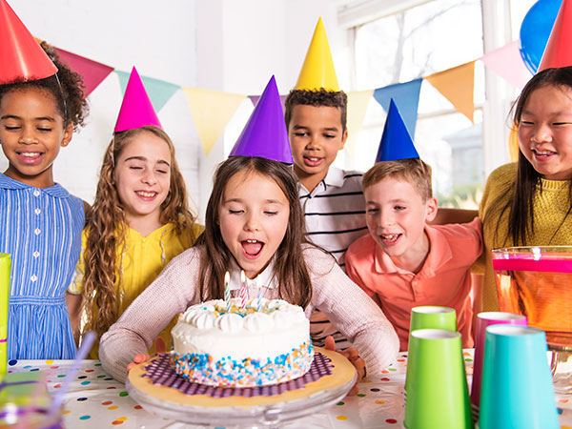
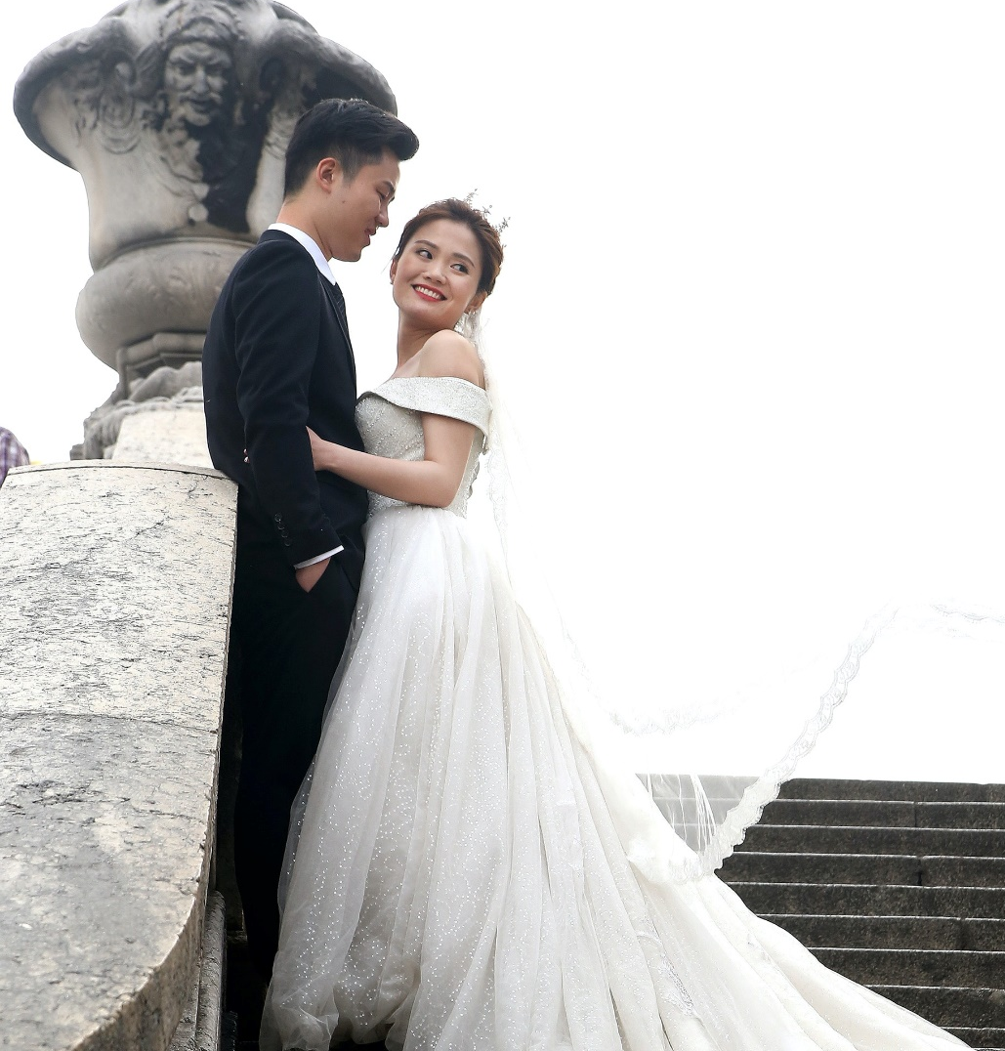
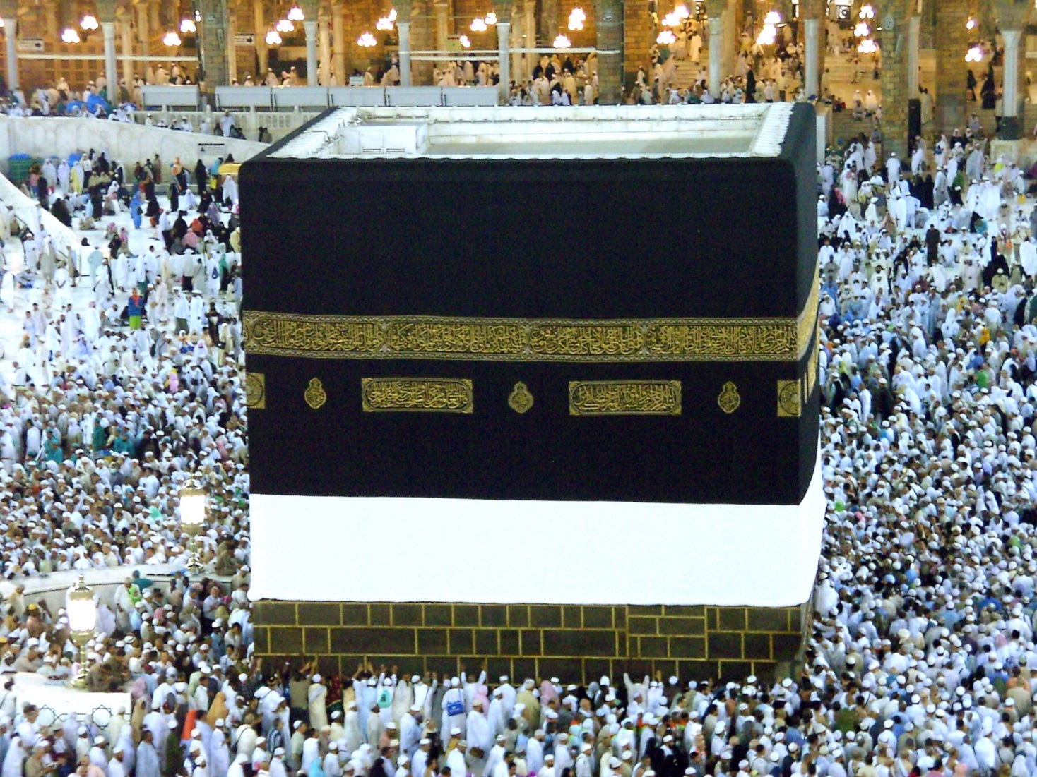
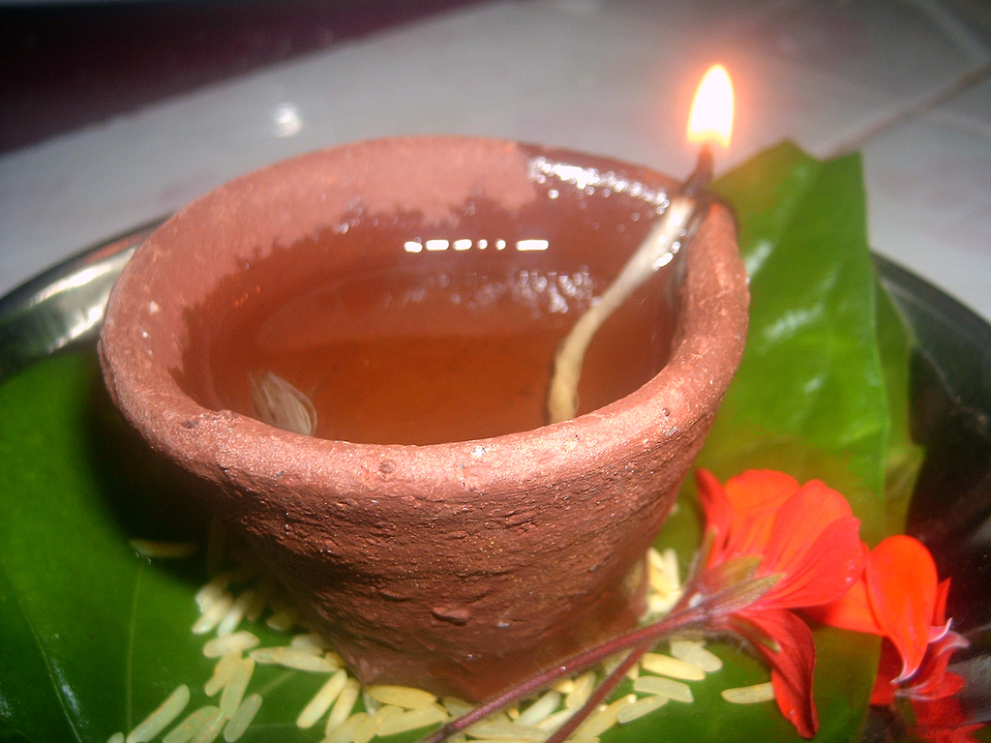
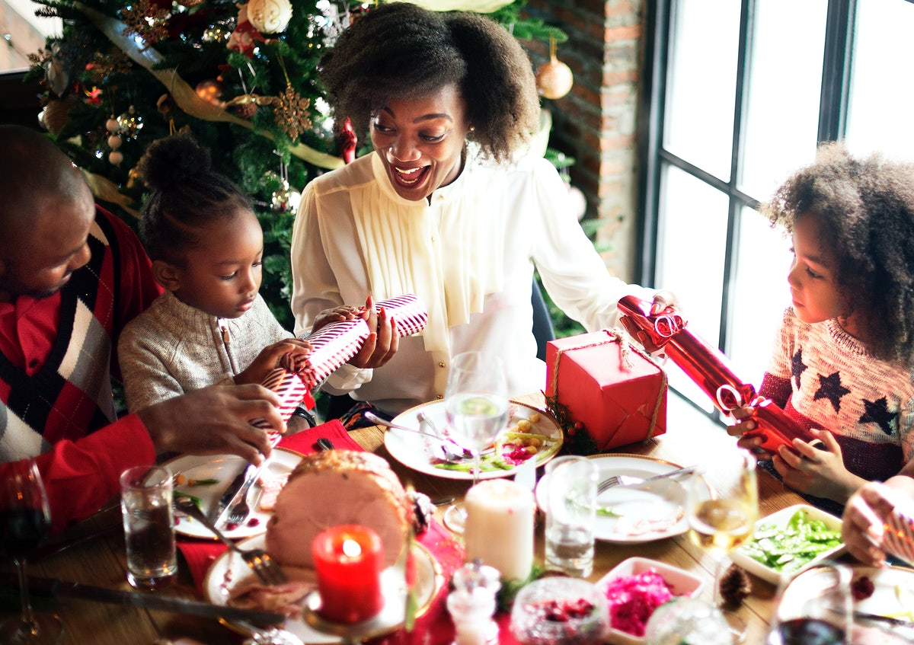
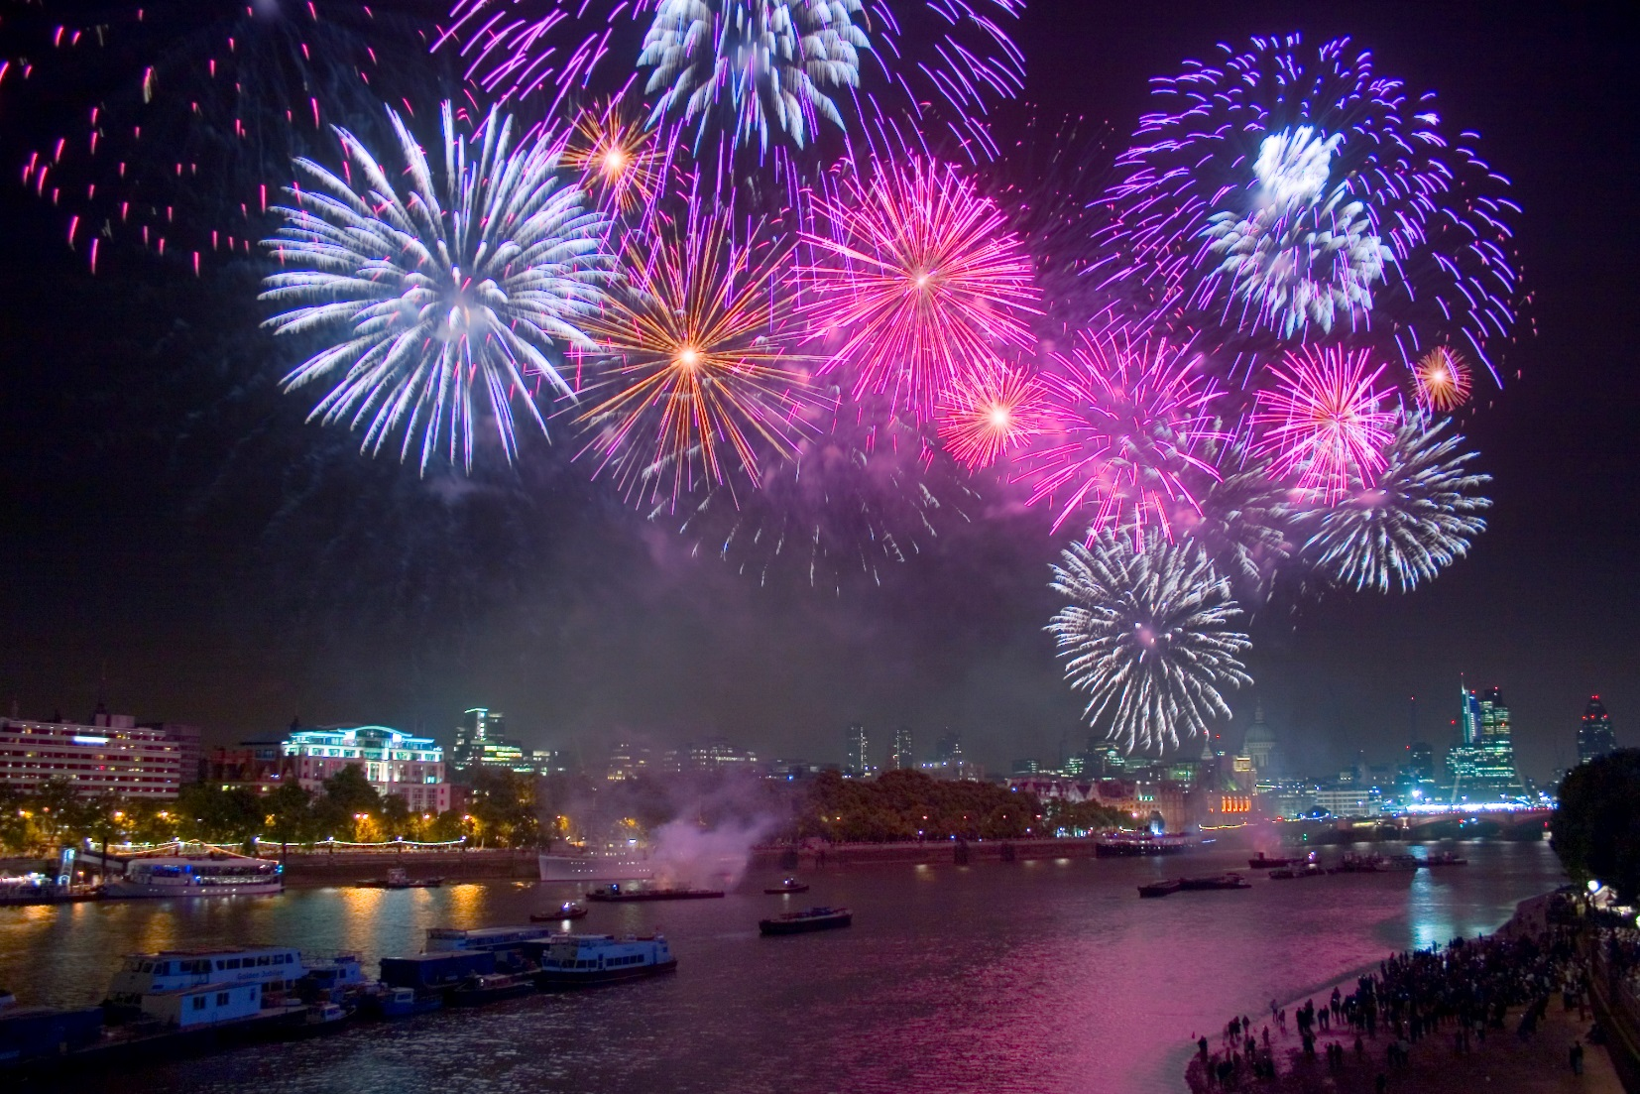
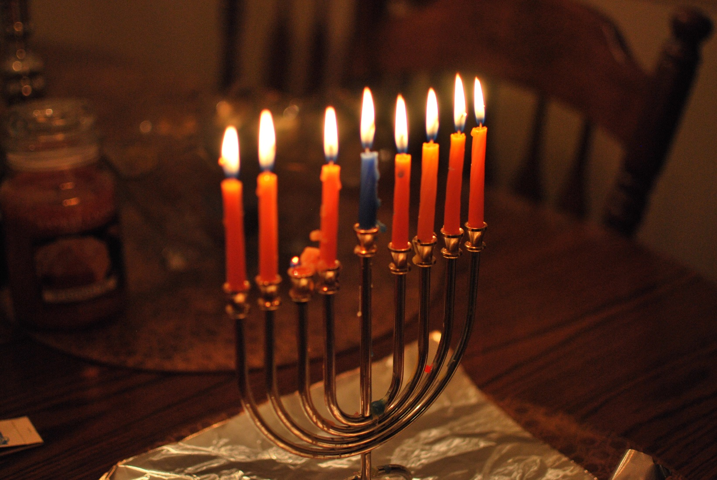
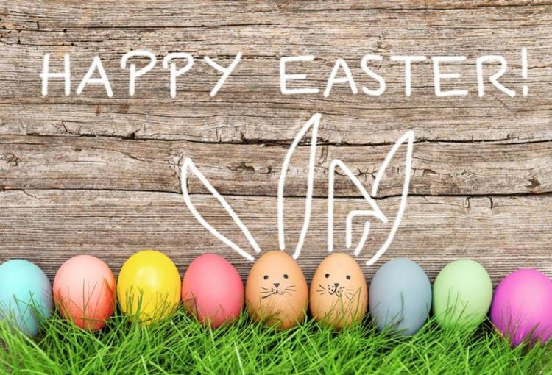
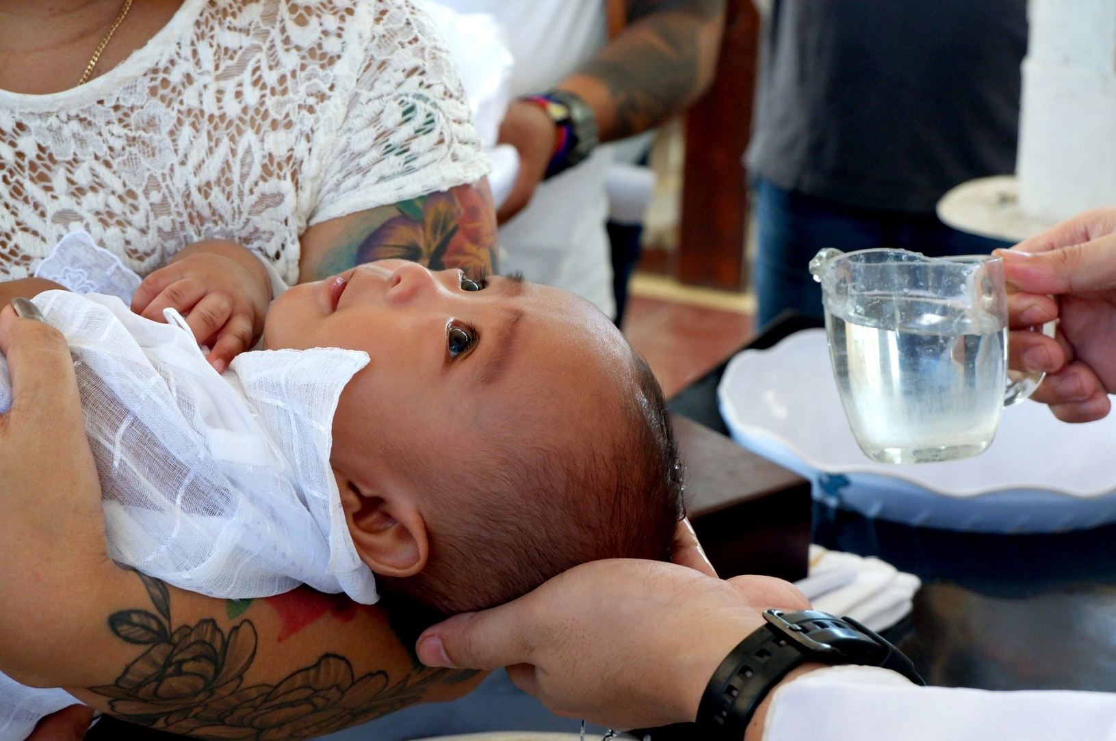
What do we celebrate?
Birthdays
Weddings
Eid
Diwali
Christmas
Celebrations
New year
Easter
Hanukkah

Slide 5
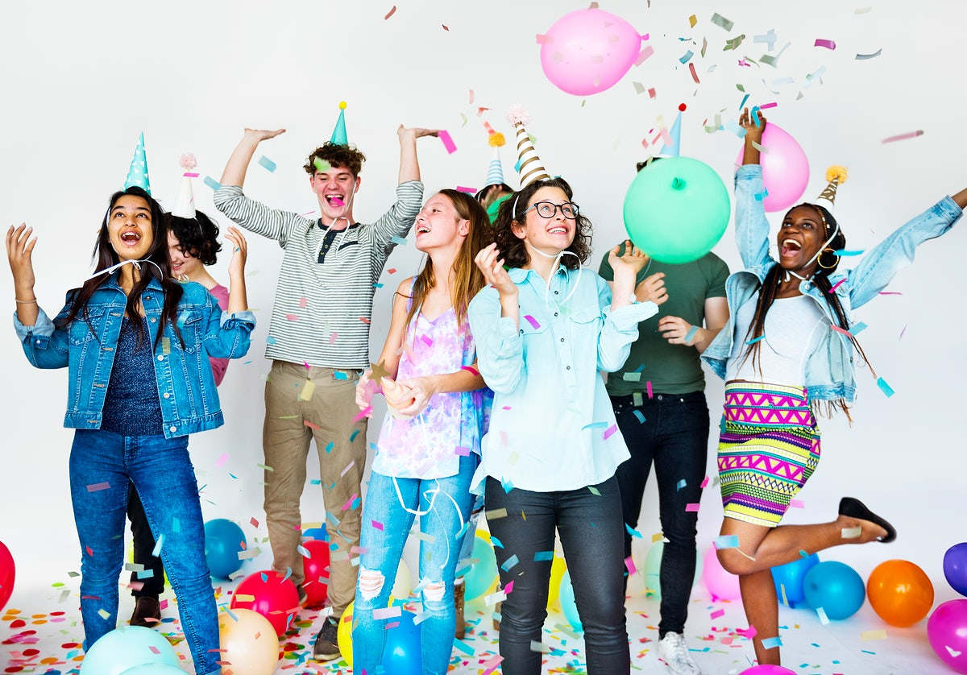
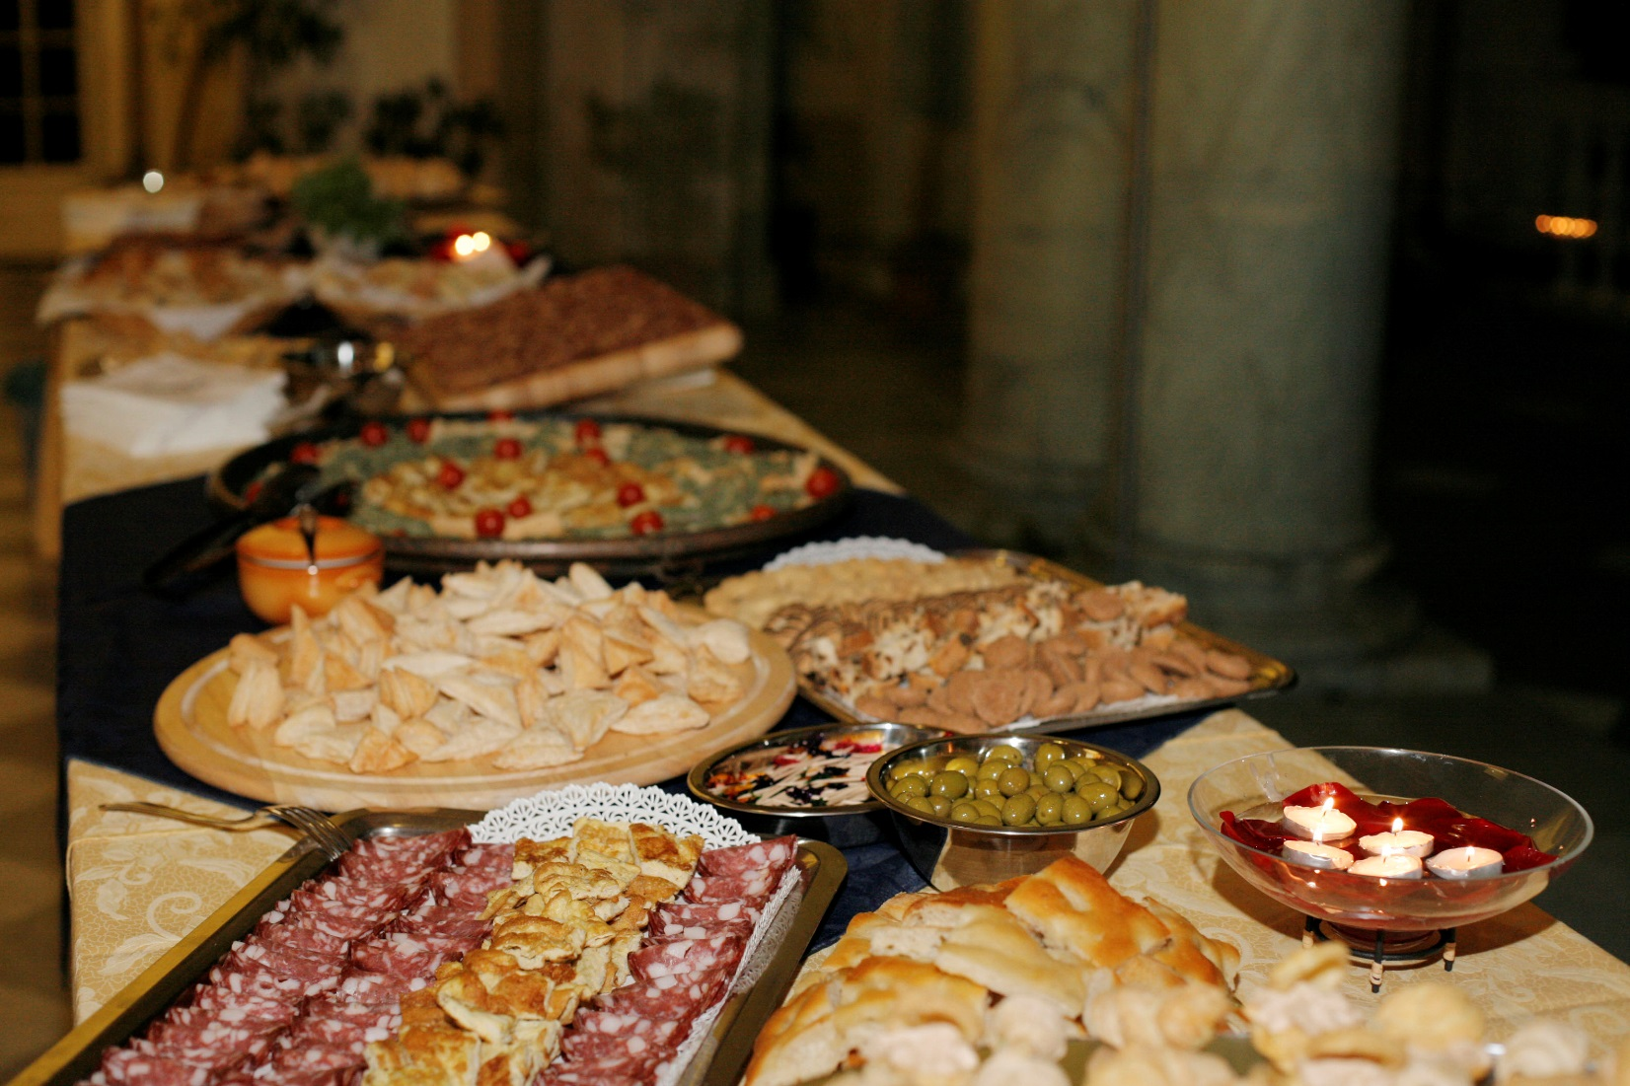
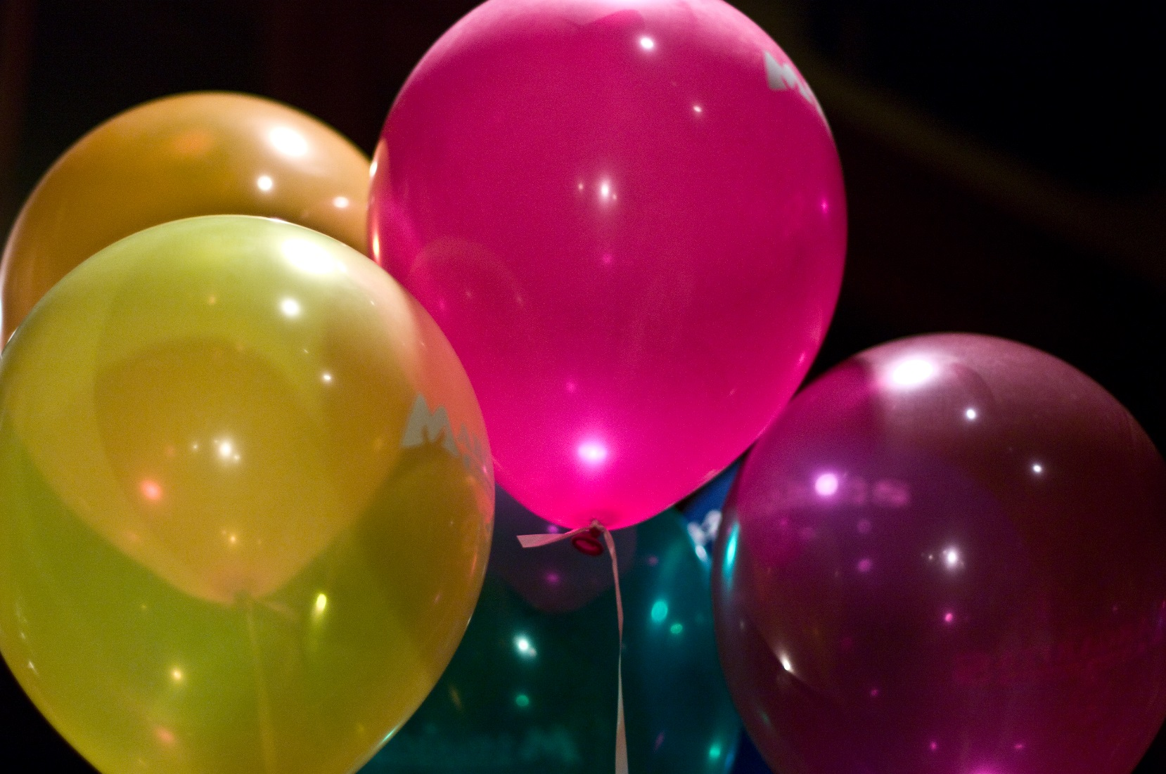
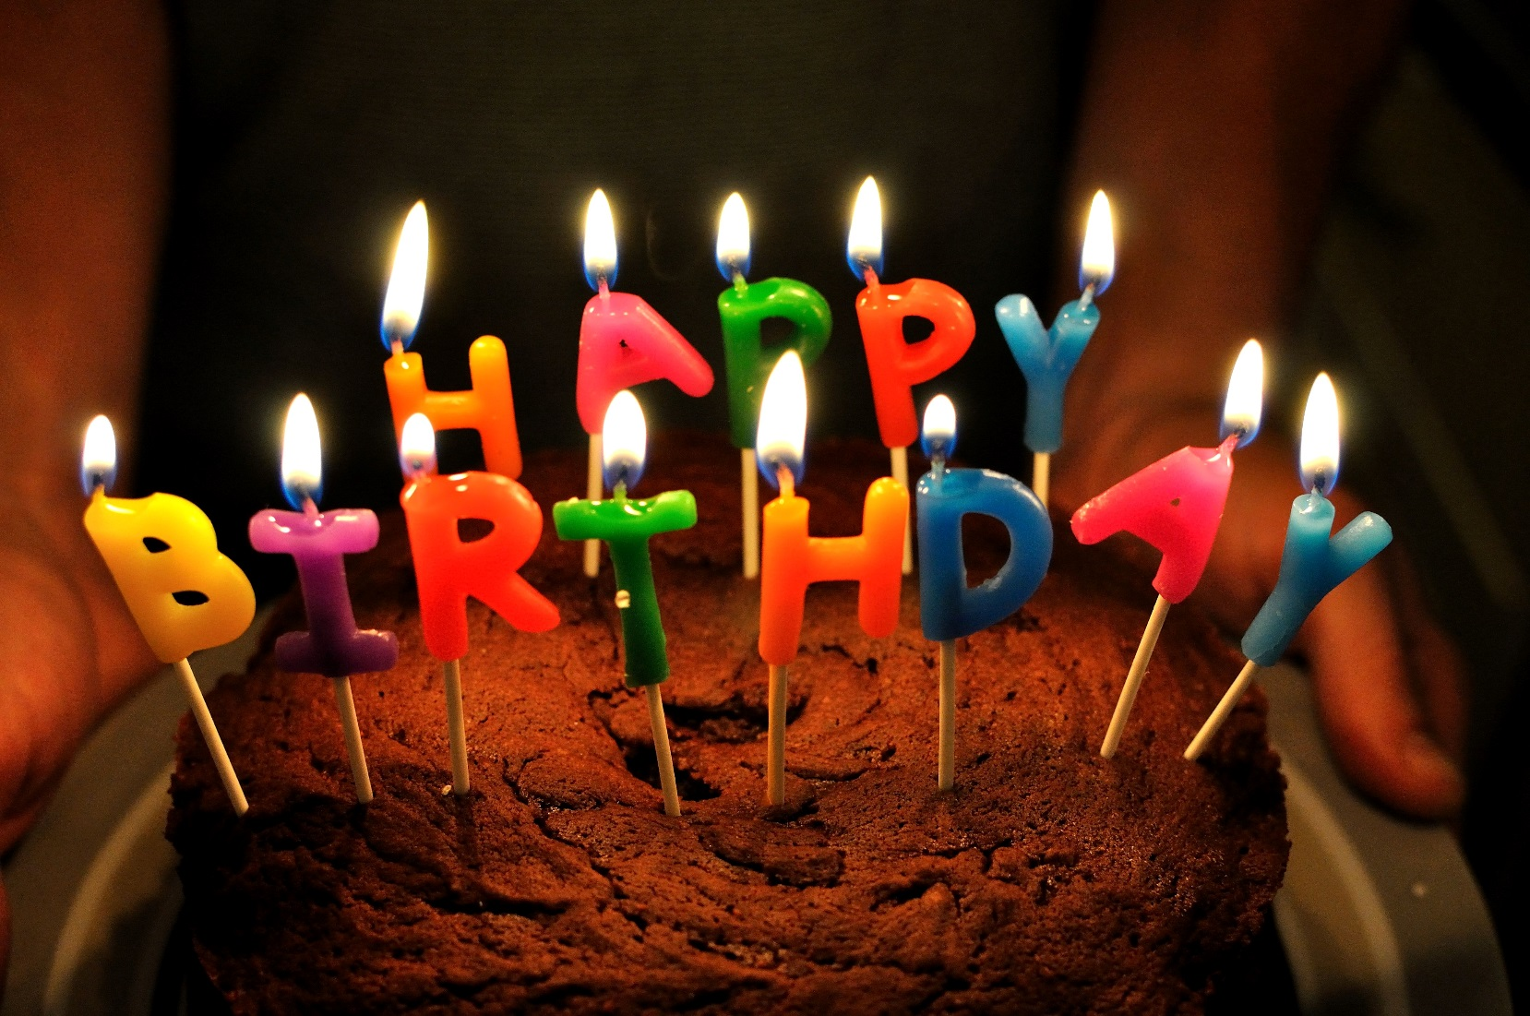
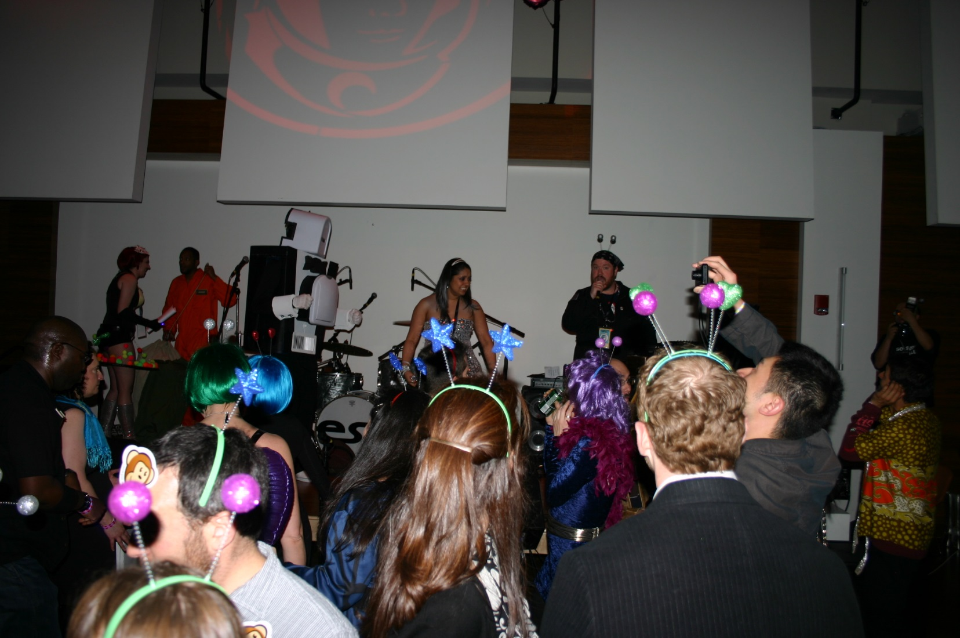
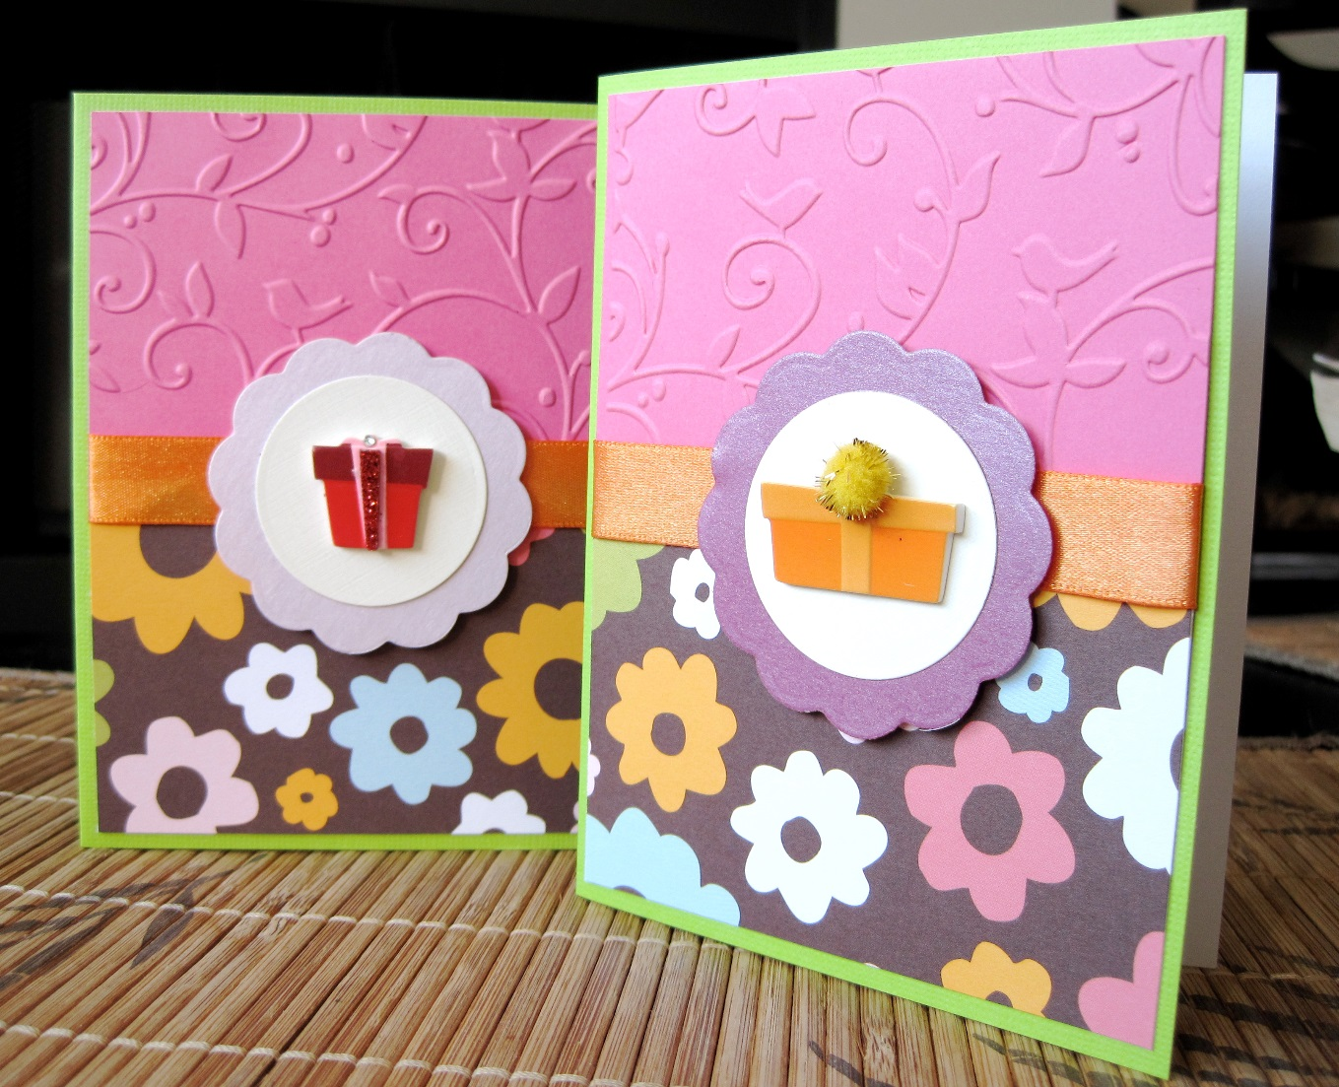
What do we have at celebrations?

Slide 6
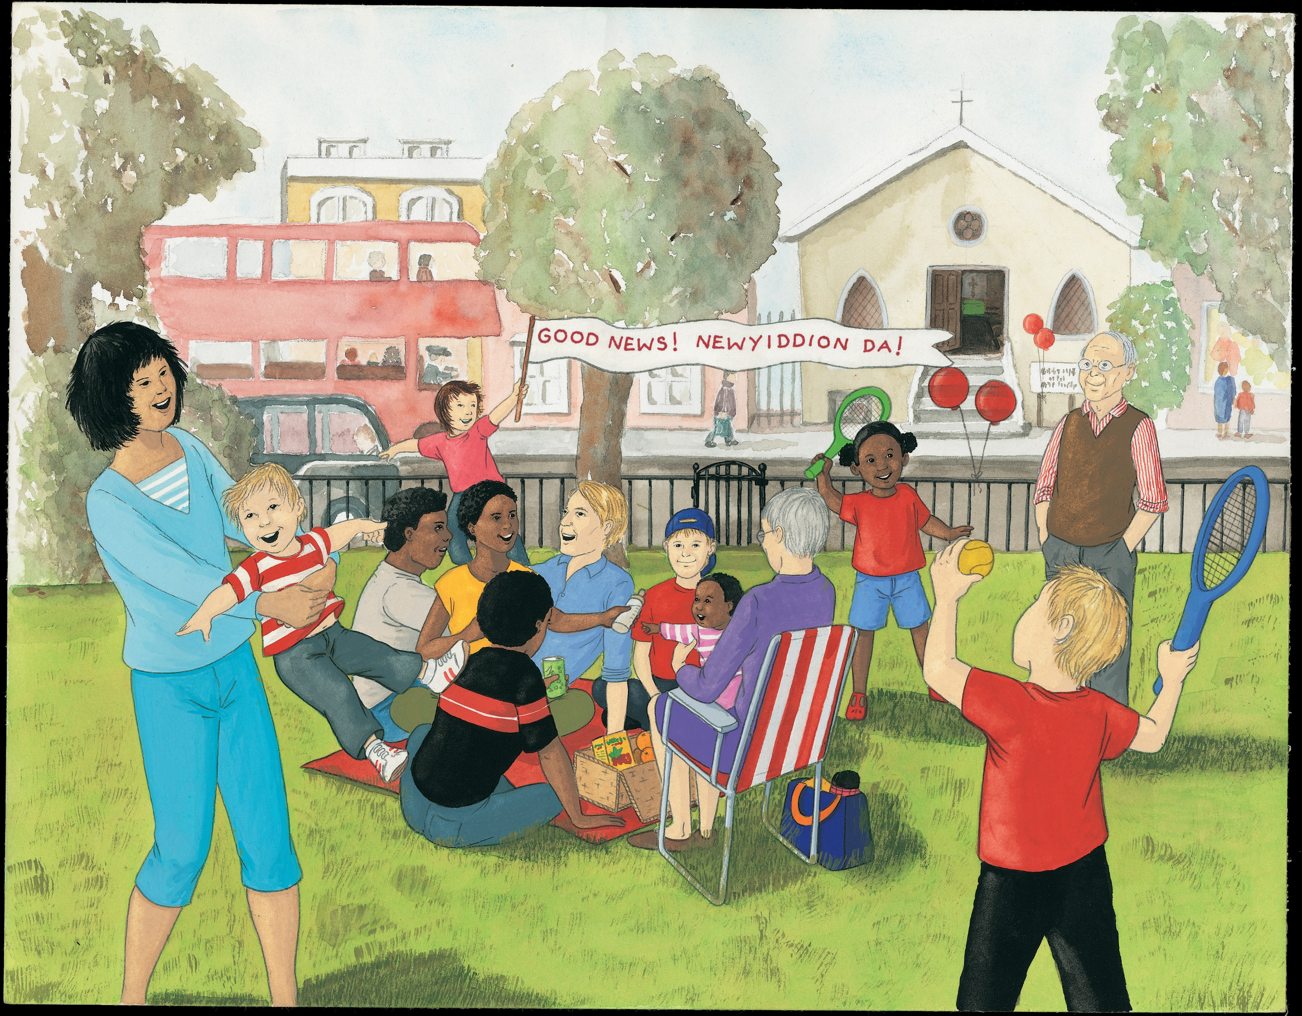

Slide 7
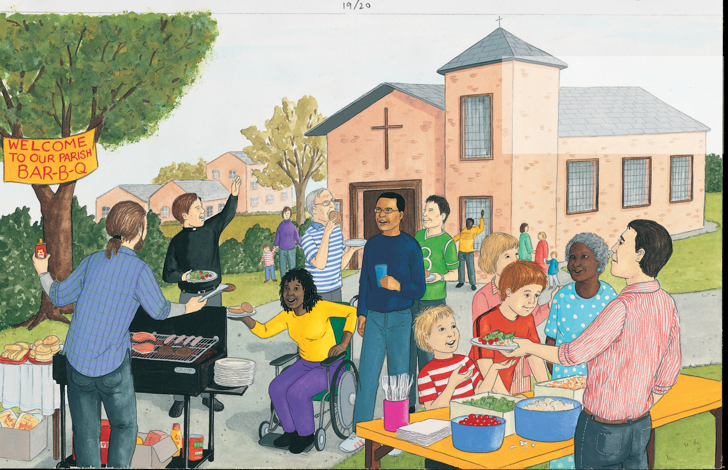

Slide 8
Task time.
We are going to plan a welcome back to school party, first we need to make the invitations. Can you make an invitation to invite someone special to our party ?
It could be to goldilocks or to a special person in your life.
Our next objective is to plan what food we will have at the party. Can you try and make a list of the food we should have ?
Draw some pictures of these items.

Slide 9
Nursery Prayer
From my head to my heart, to my shoulder to my shoulder. I belong to Jesus.
Dear god you know me and you love me.
I want to know you and love you too.
Amen
From my head to my heart, from my shoulder to my shoulder. I belong to Jesus.

